Slide 1
Introduction To Engineering Uses Of Physics-Based Ground Motion Simulations: Current Directions in Ground Motion Simulation
Kim Olsen
San Diego Sate University
July 22 2014, NCEE Anchorage, AK

Slide 2
Outline
Structural engineers need 10Hz+ ground motion time histories for design purposes
Current procedures for synthetic broadband time history generation usually combine low-frequency (≤1Hz) physics-based and high-frequency stochastic components
Fully 3D physics-based broadband time histories are desirable, but computationally expensive

Slide 3
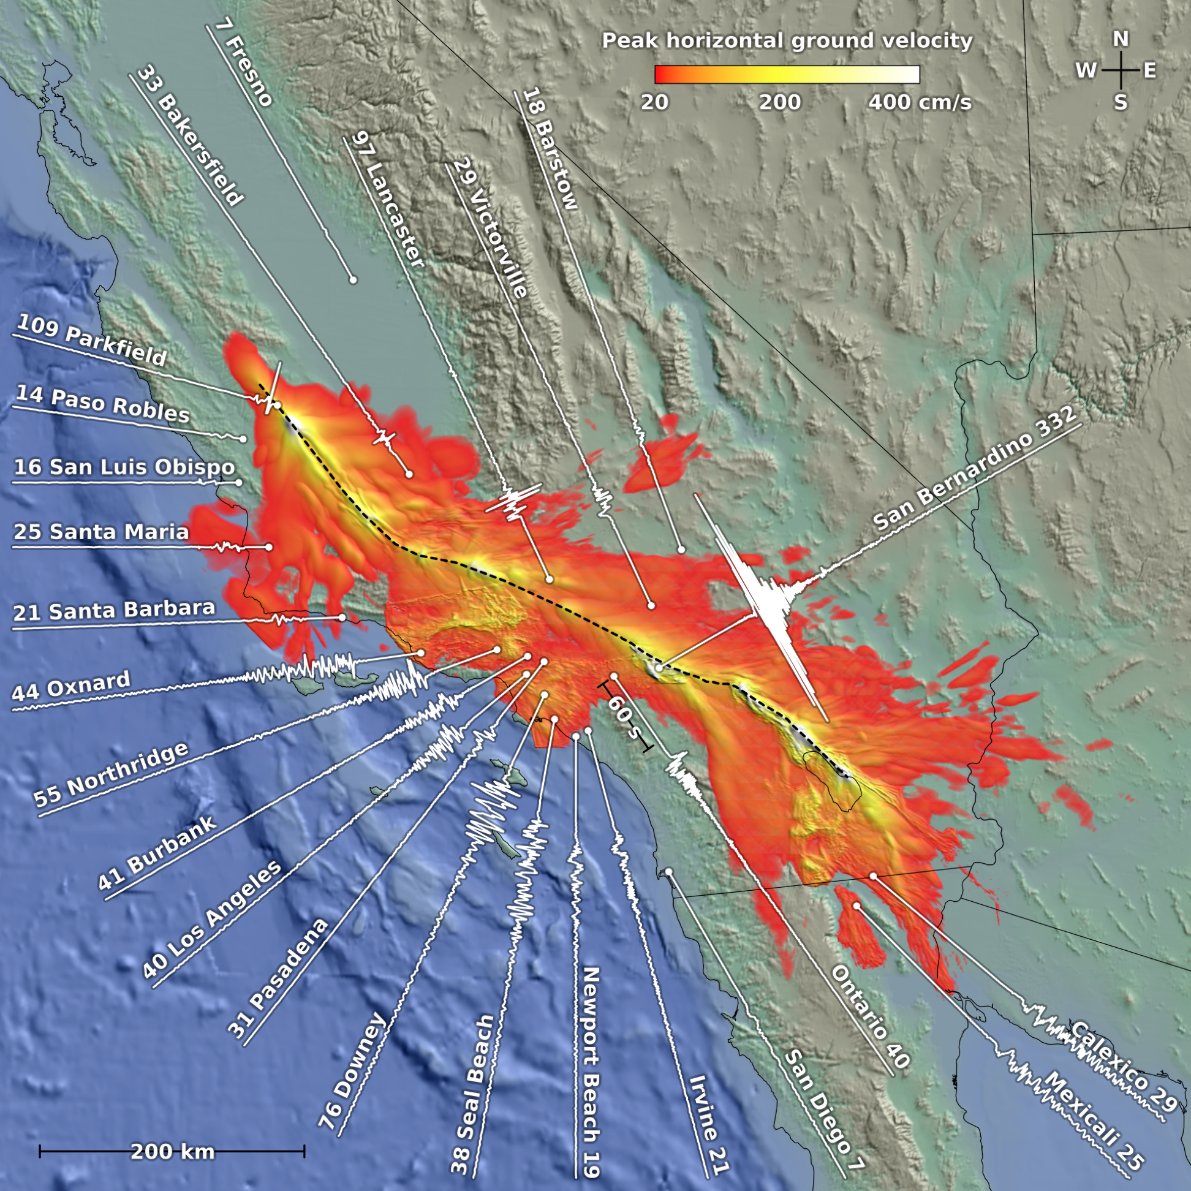
Computational Resources
90%
efficiency
M8
Ideal scaling
Problem Size: 224³ grid elements per core

Slide 4
Some Features Required in Physics-based Broadband Simulation:
Source and media complexity on the order of 10-100s of meters!
Nonlinear/plastic soil effects

Slide 5
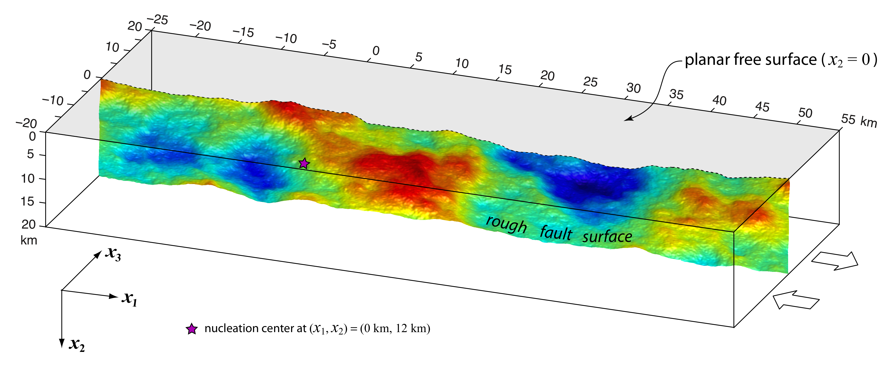
Source Complexity: Self-similar Geometrical Heterogeneities
Day and Shi, 2013

Slide 6
Media Complexity
In 3D, a fractal distribution has a high wave-number decay of the power spectrum P(k) as:
where H is the Hurst number, k_{corner} is a wave number below which the spectrum is approximately constant

Slide 7
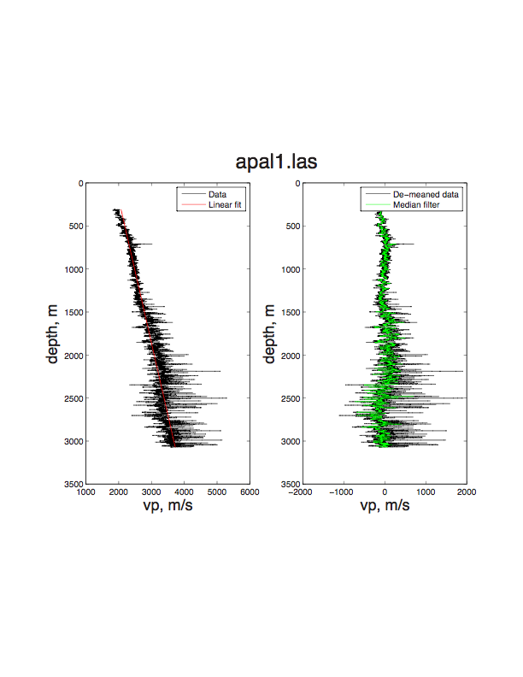
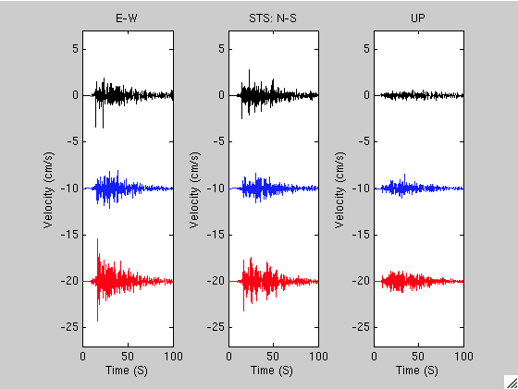
Constraining the Parameters of the Small-scale Heterogeneities
Savran and Olsen, 2014
Analysis of 38 LA basin sonic logs:
Vertical Correlation Length 25-150m
Hurst Exponent 0-0.1
σ 5-10%

Slide 9
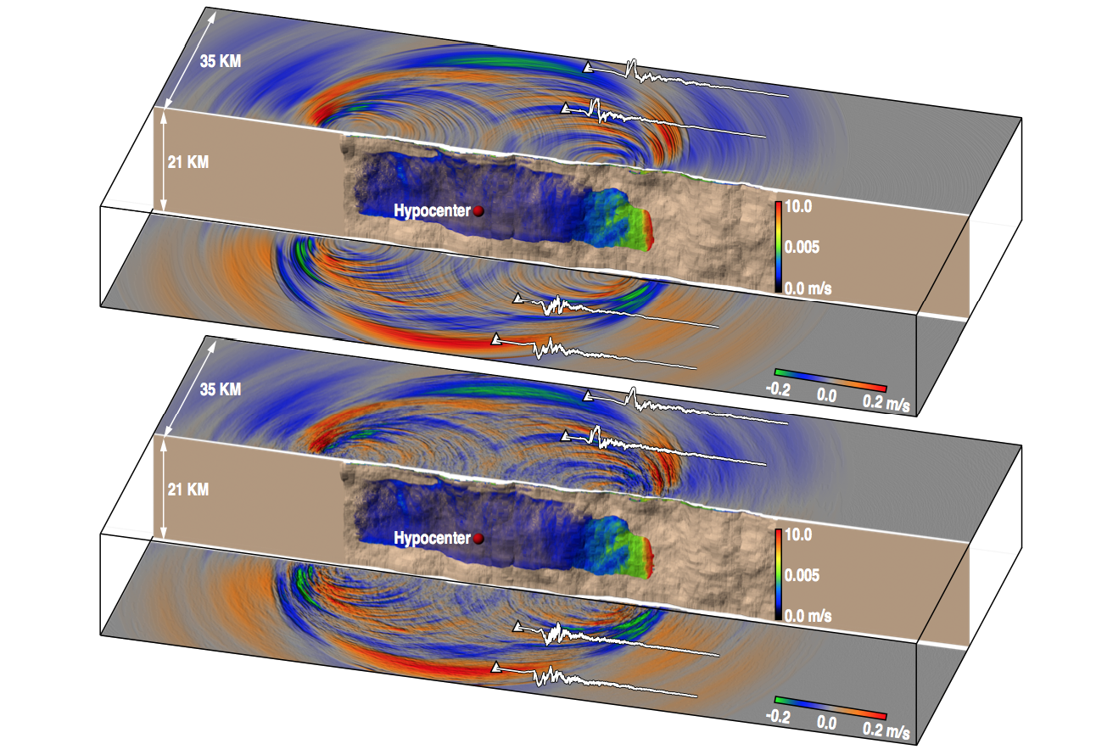

Slide 10
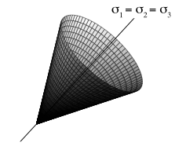
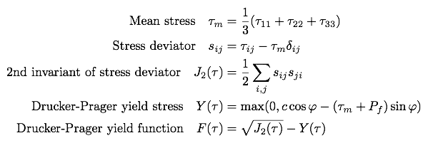
Implementation of Damage Rheology in AWP
Non-associative Drucker-Prager plasticity with yielding in shear

Slide 11
Cohesion Models

Slide 12
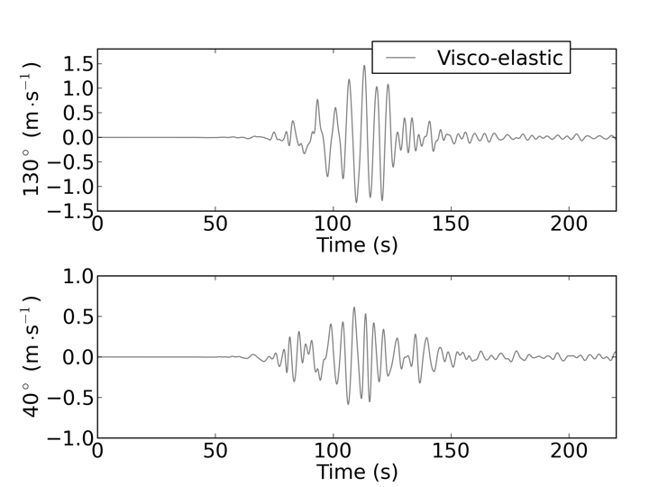
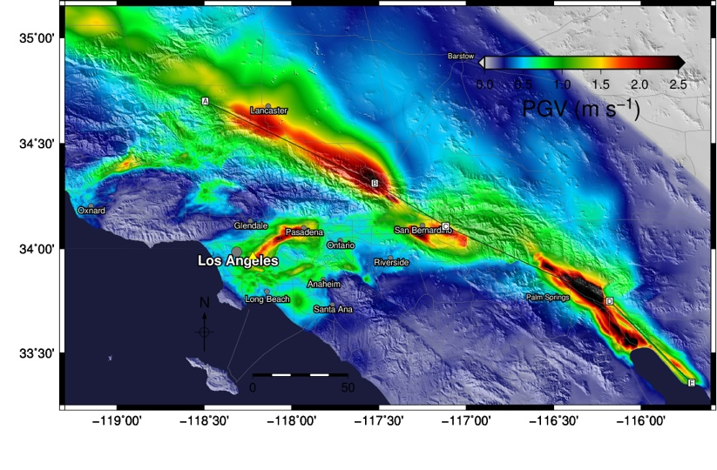
ShakeOut Scenario
Based on kinematic source description for the M7.8 ShakeOut scenario (Graves et al., 2008)
Visco-elastic medium

Slide 13
Visco-elastic Versus Visco-elastic-plastic ShakeOut

Slide 14
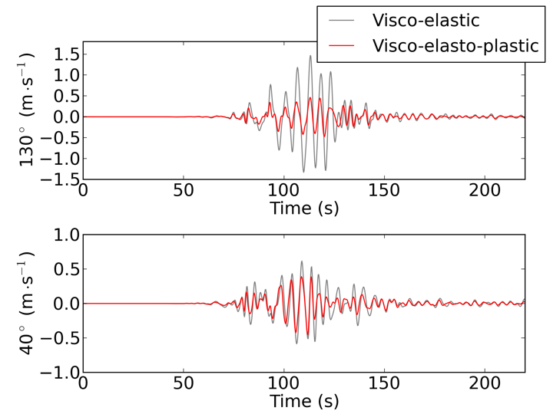
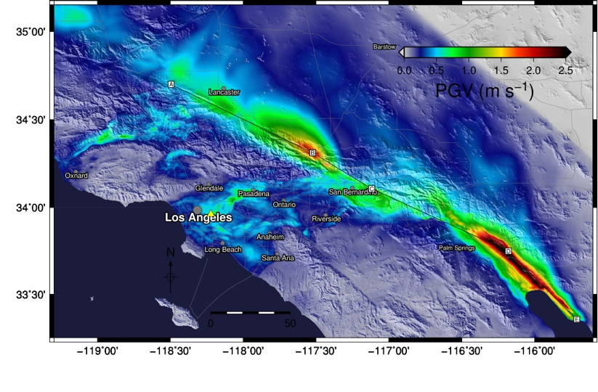
Visco-elastic Versus Visco-elastic-plastic ShakeOut
Visco-elastic
Visco-elasto-plastic
Annual Meeting of the Seismological Society of America, April 17-19 2013, Salt Lake City, UT
14

Slide 15
Summary
On-going efforts (SCEC) to bring physics-based 3D simulations to 10 Hz+
Large-scale 3D variations inherent in CVMs (tomography, etc), small-scale heterogeneities from statistical models
Near-fault nonlinear effects can significantly affect ground motions, including long-period far-field sites (including long periods)

Slide 16
Short-period Comparison to GMPEs
M7.2 Strike-slip

