Slide 1
Factors Controlling Long-Period Deterministic Ground Motion Synthetics
Kim Olsen, San Diego State University
with contributions from:
SSA Annual Meeting, Monterey, CA 4/09/09 11:30am
Amit Chourasia, SDSC
Victor Cruz-Atienza, UNAM
Yifeng Cui, SDSC
Luis Dalguer, ETH-Zurich
Steven Day, SDSU
Andreas Geisselmeyer, Ulm University
Tom Jordan, USC
Phil Maechling, USC
Harold Magistrale, Pomona College
Martin Mai, ETH-Zurich
John Mayhew, SDSU
Bernard Minster, SIO
David Okaya, USC
Jim Pechmann, U of Utah
Daniel Roten, SDSU
Bill Stephenson, USGS, Golden
Jing Zhu, SDSC

Slide 2
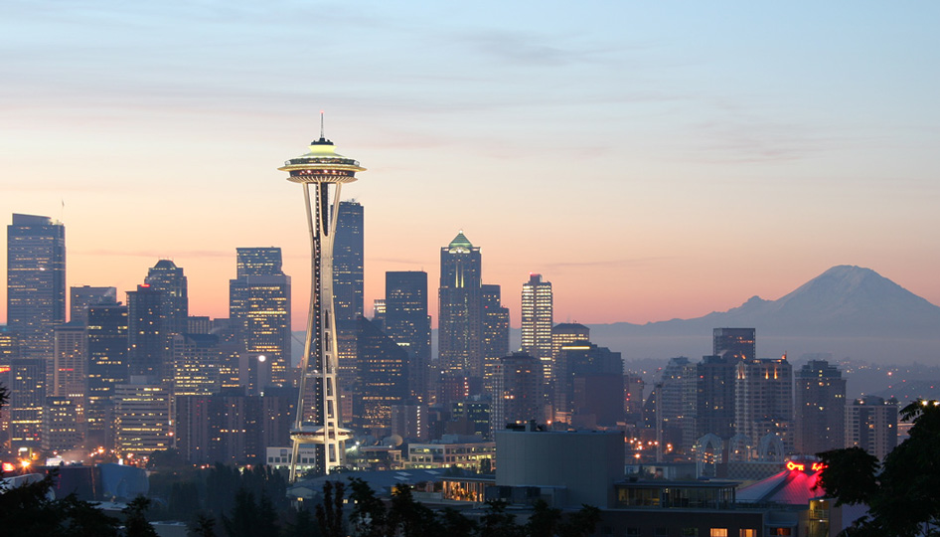
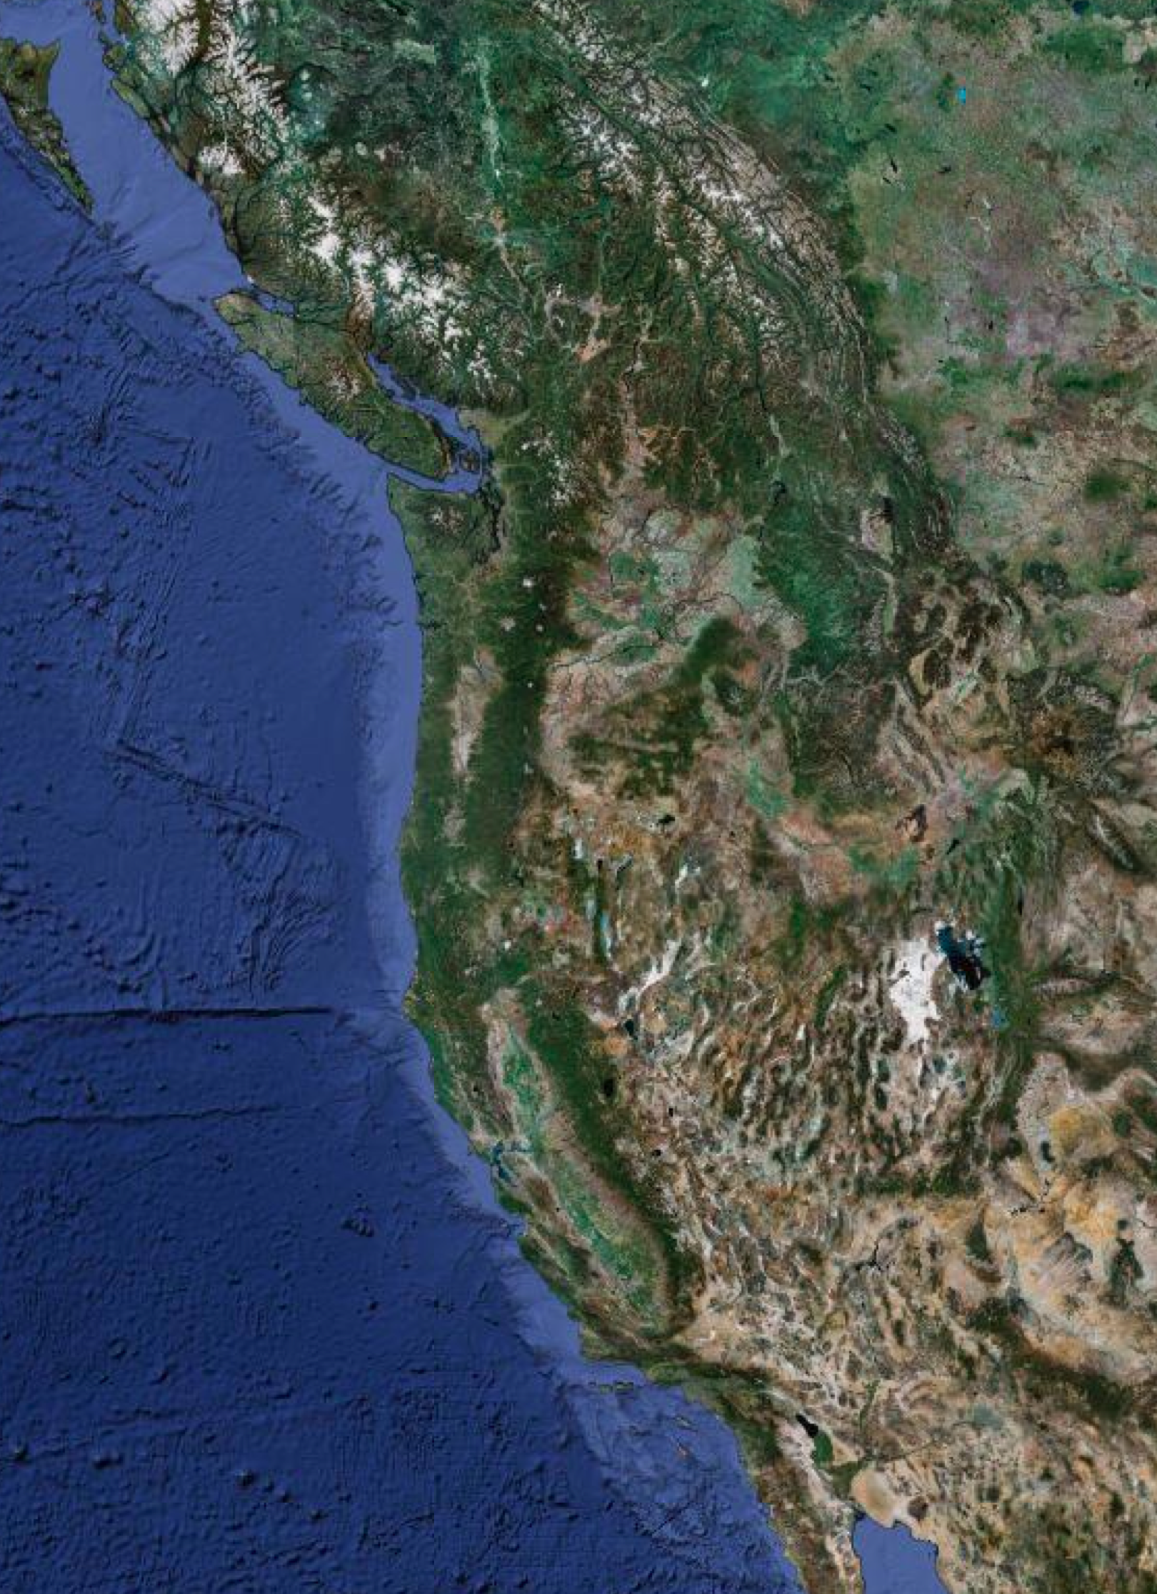
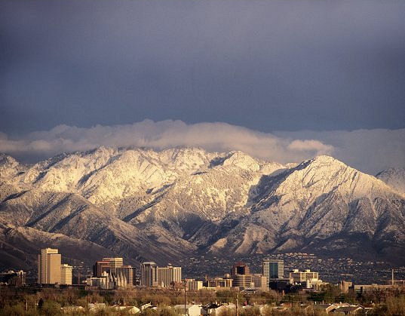
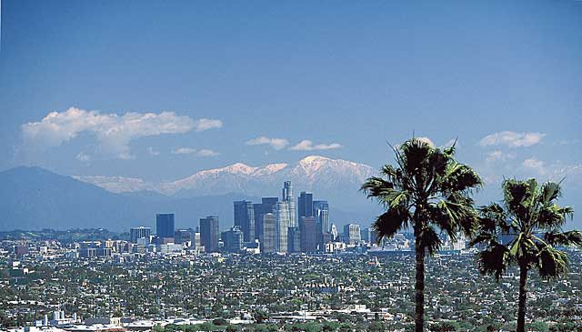
Earthquake Scenario Locations:

Slide 3
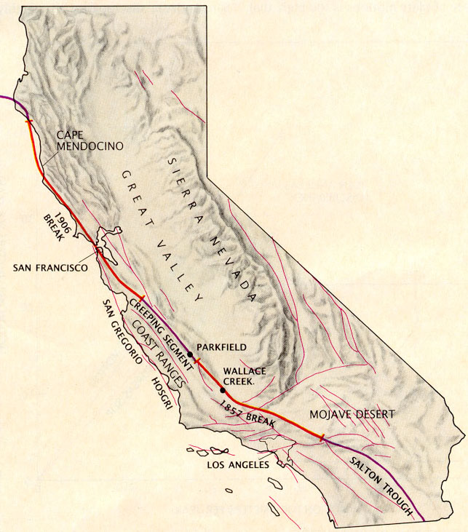
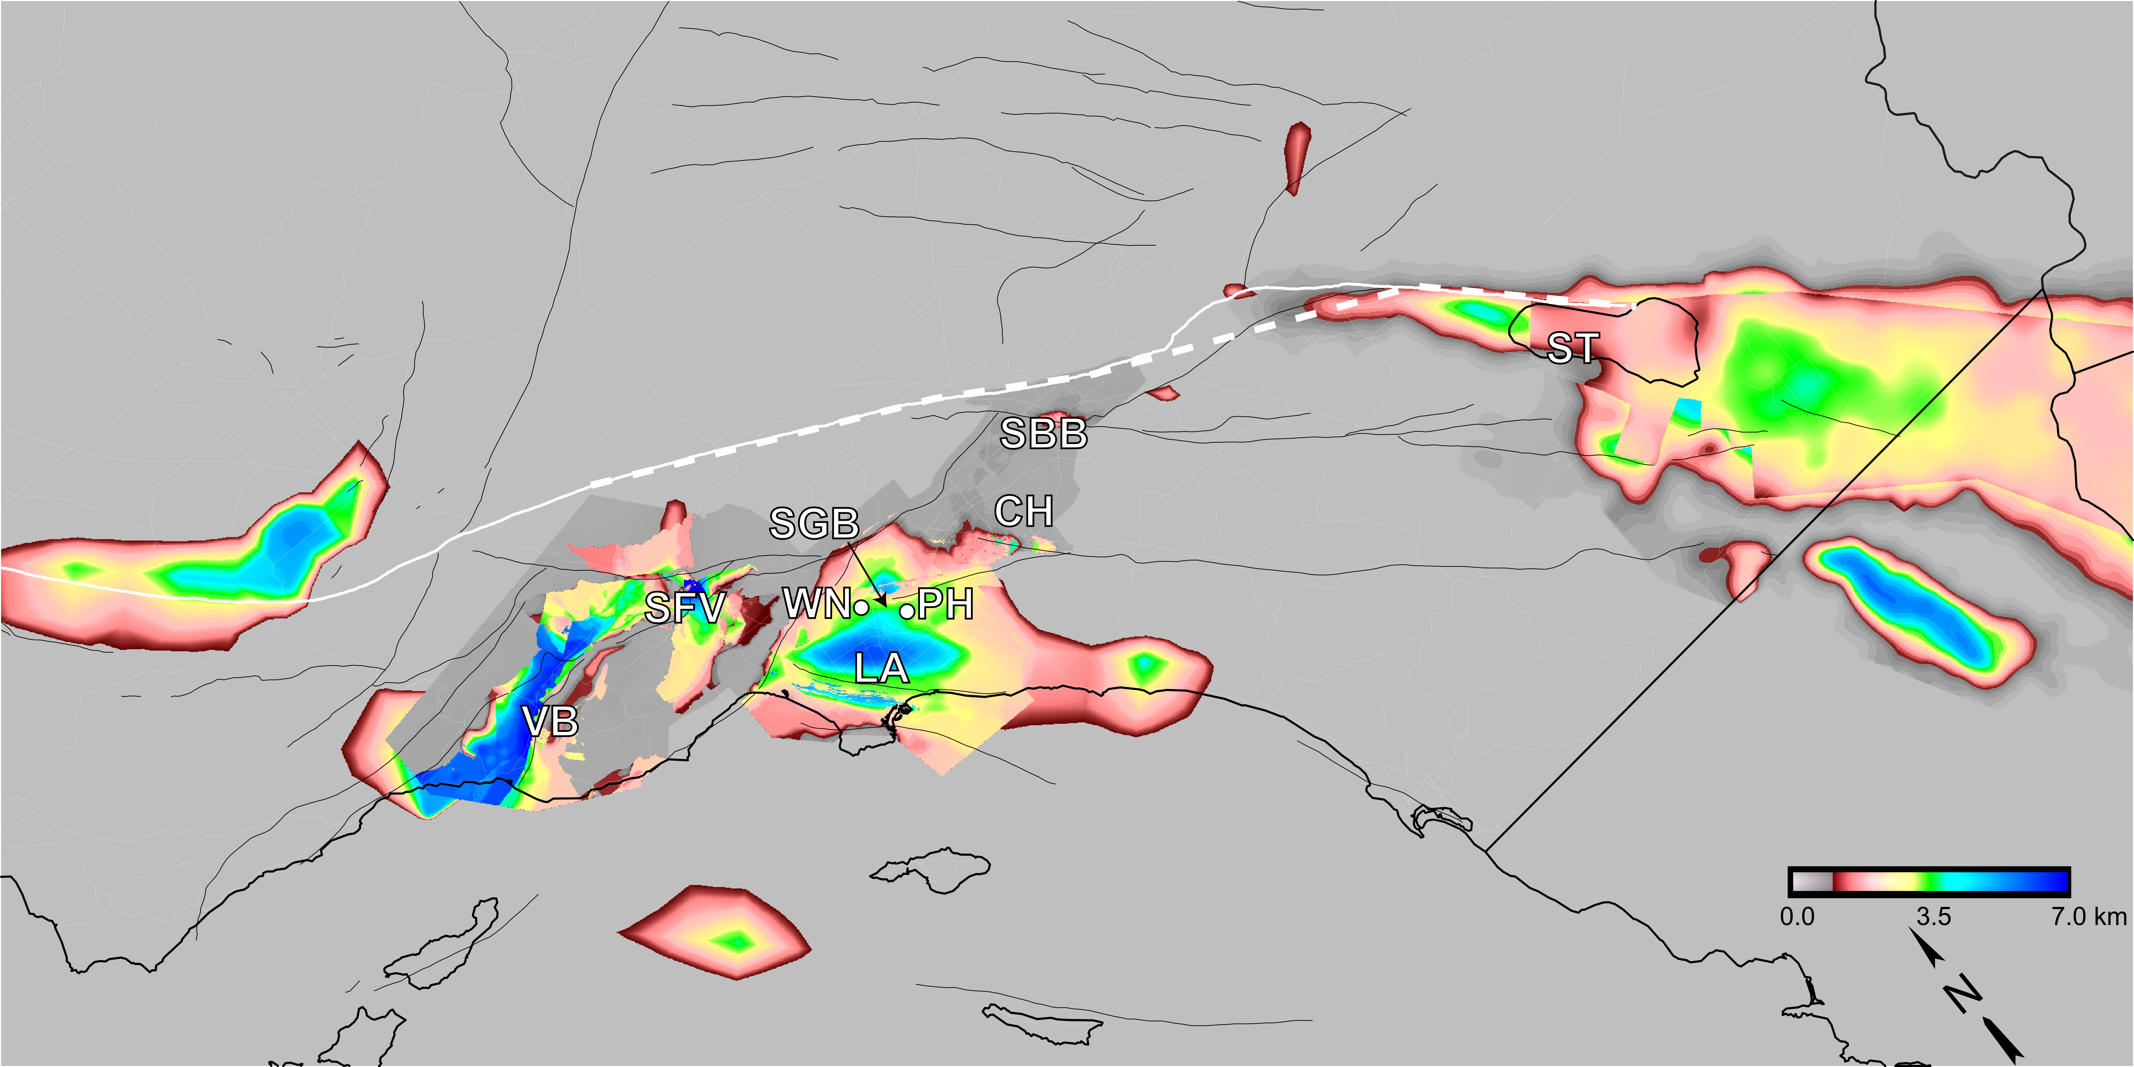
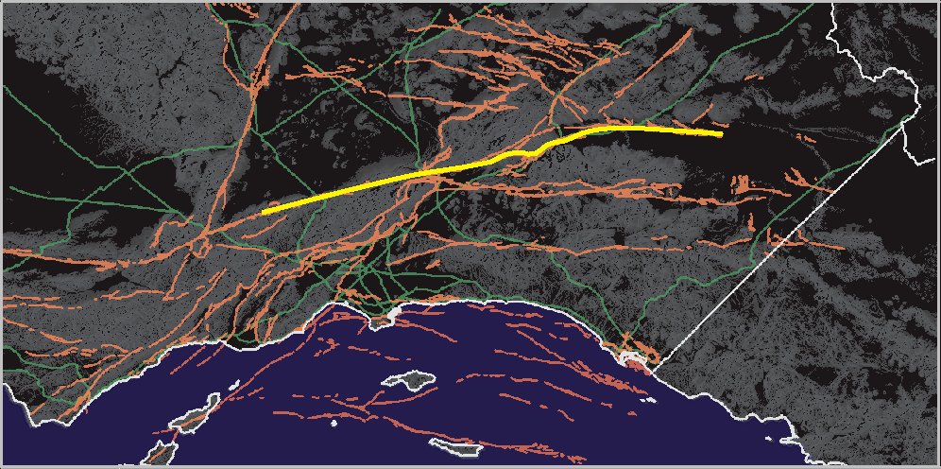
Southern California
M7.8 ShakeOut M7.7 TeraShake

Slide 5
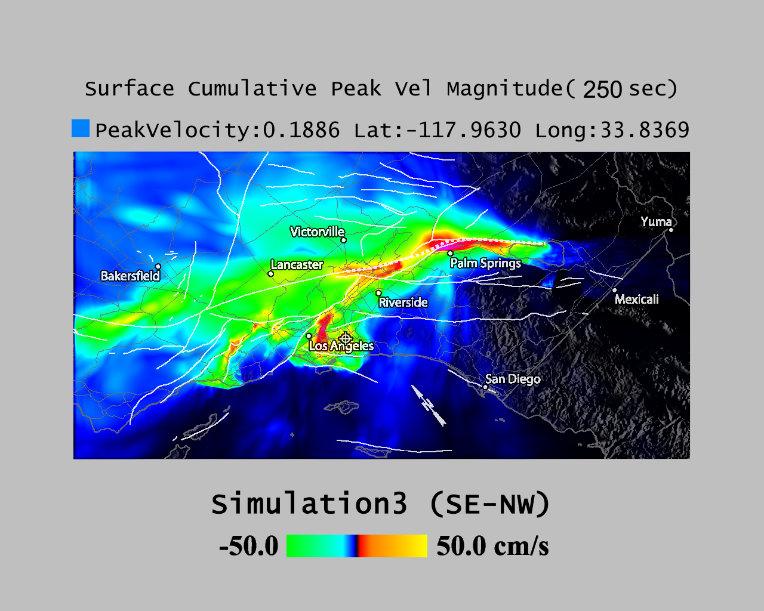
http://visservices.sdsc.edu/projects/scec/terashake/1.3/movies/Terashake1.3-surf-cumu-vmag.mov

Slide 6
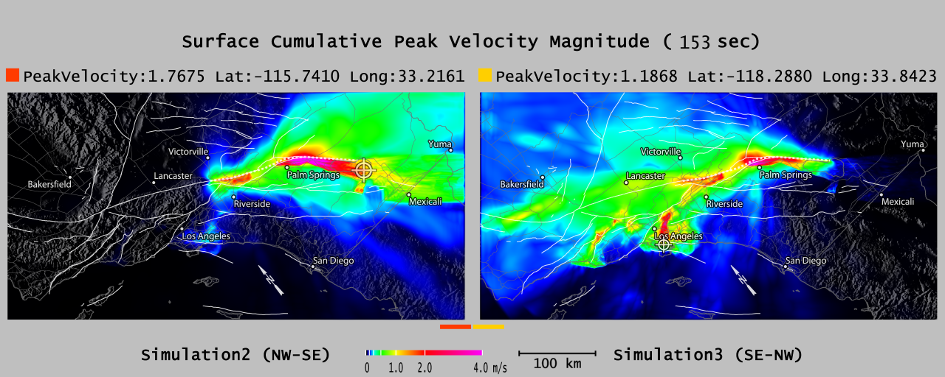
Sensitivity to Epicentral Location
NW-SE Rupture SE-NW Rupture

Slide 7
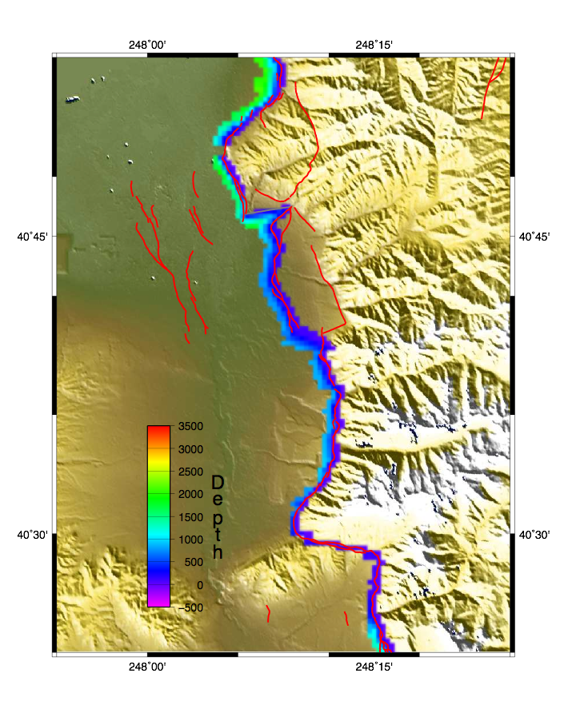
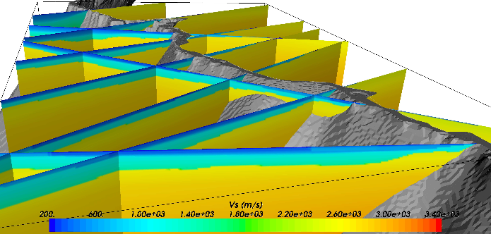
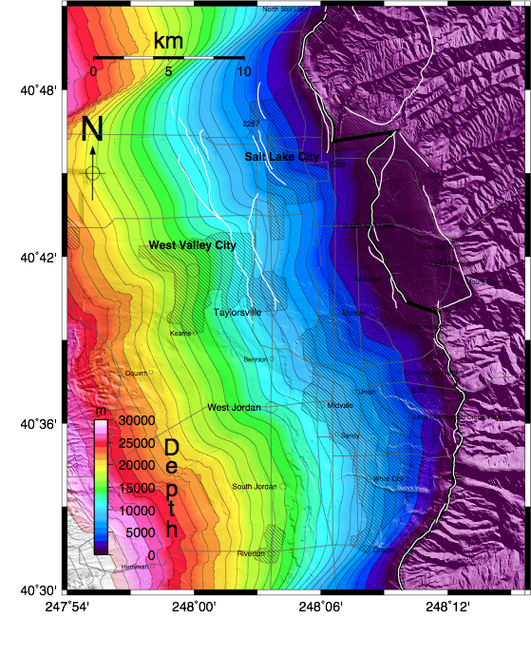
Wasatch Front, Utah
Wasatch Front Community Velocity Model
Fault Model

Slide 8
M7.0 Wasatch Fault Event

Slide 10
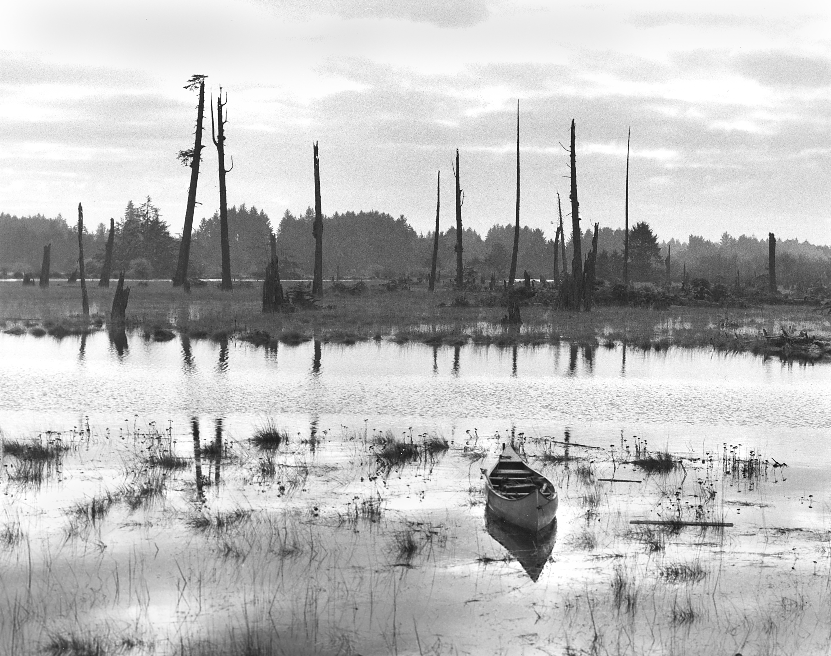
Evidence: sunken forests
Dating tree rings allows for approximate timing of the catastophe (i.e., subsidence of the coastal areas)

Slide 11
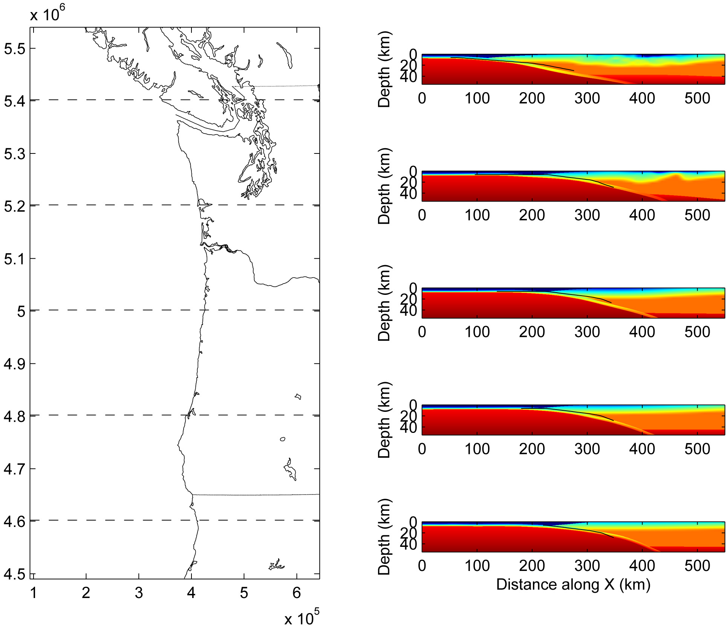
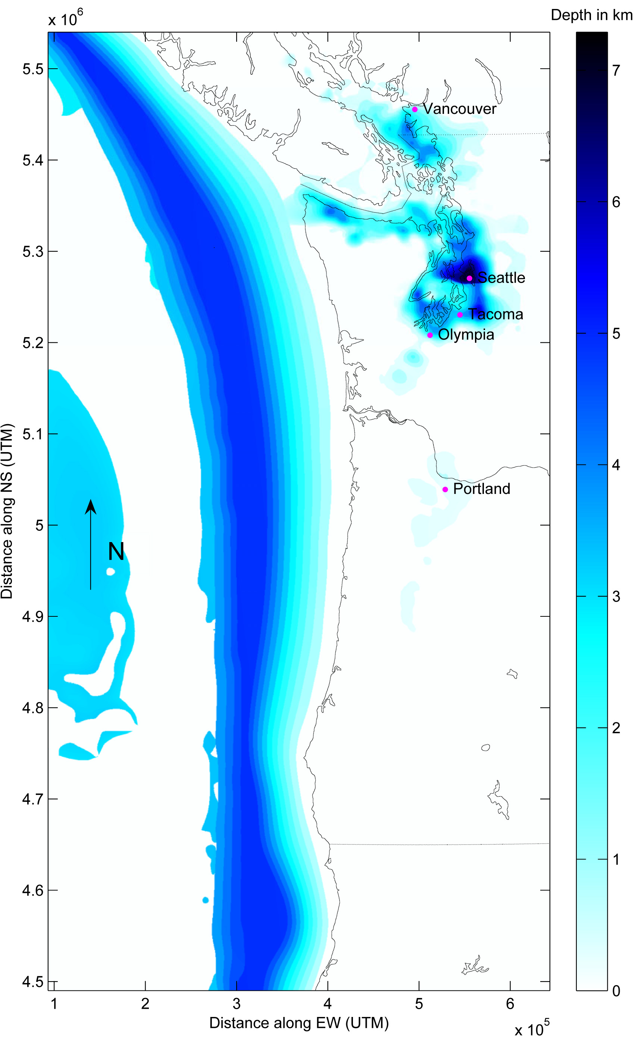
3D Crustal Model

Slide 12
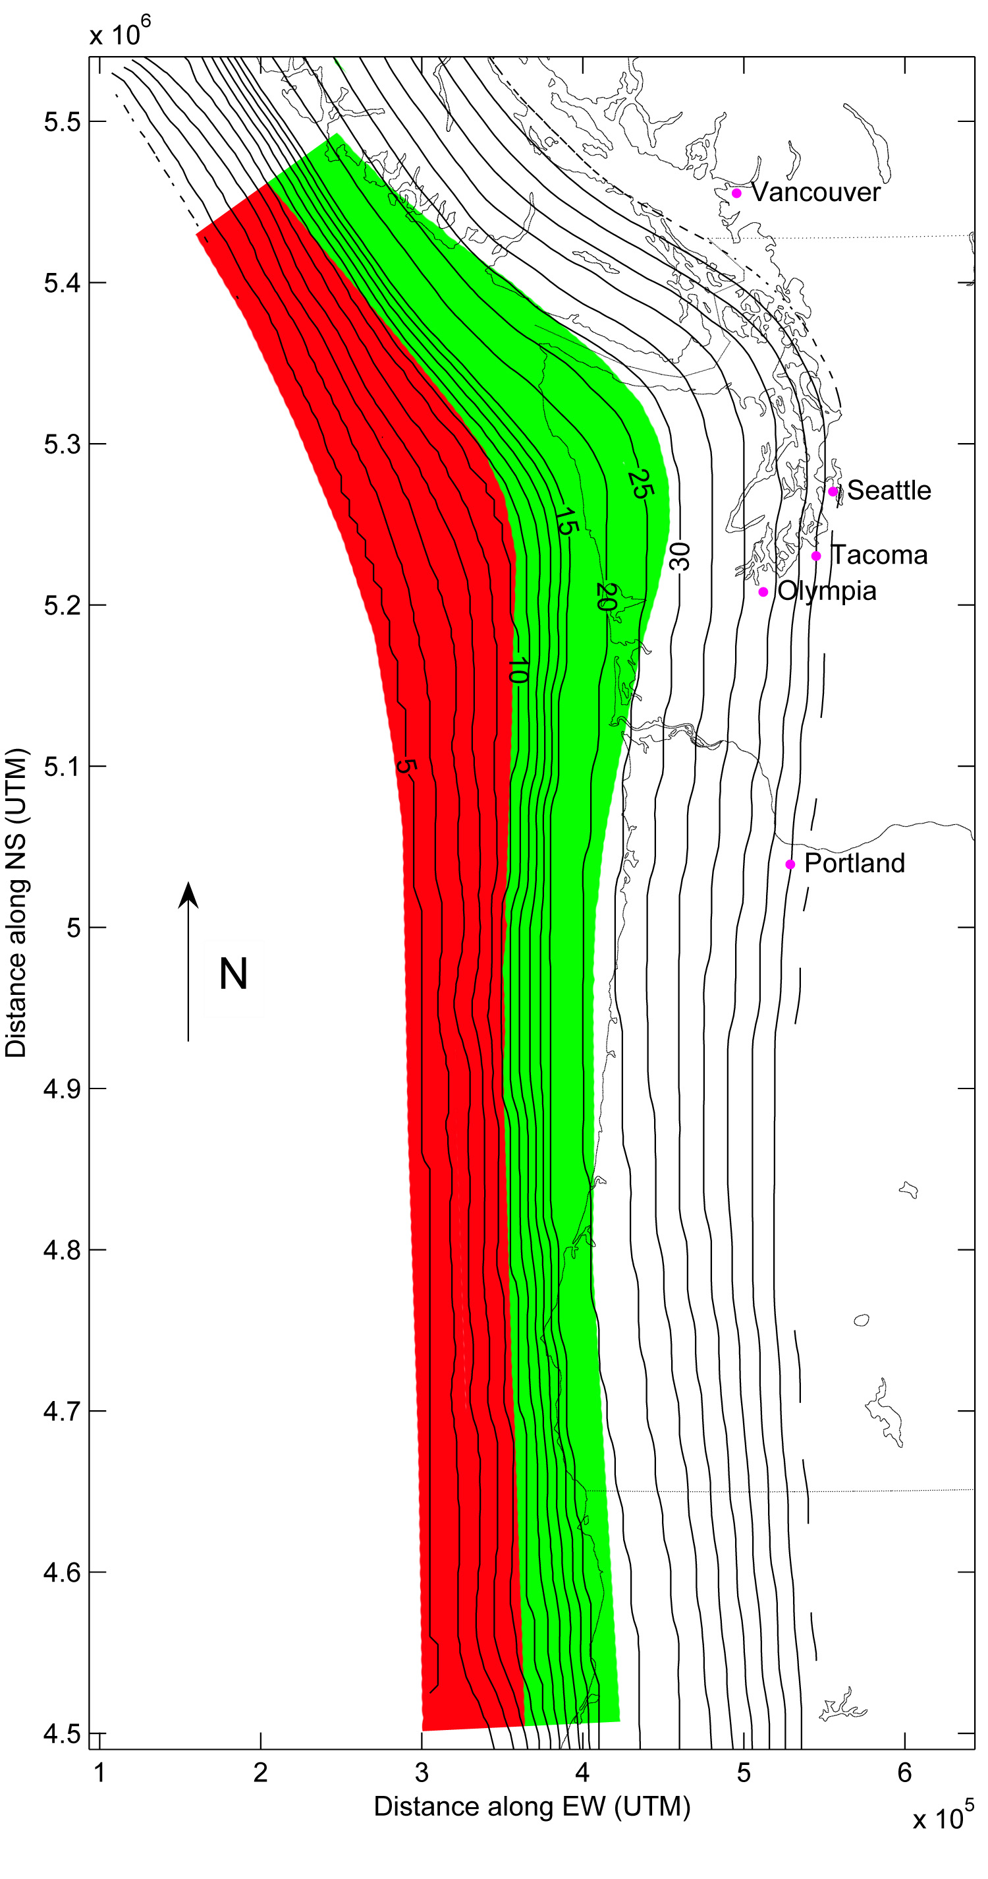
The Cascadia Subduction Zone has been divided into a locked zone (red) and a transition zone (green)
The largest moment release expected in the locked zone, with some slip extending into the transition zone

Slide 13
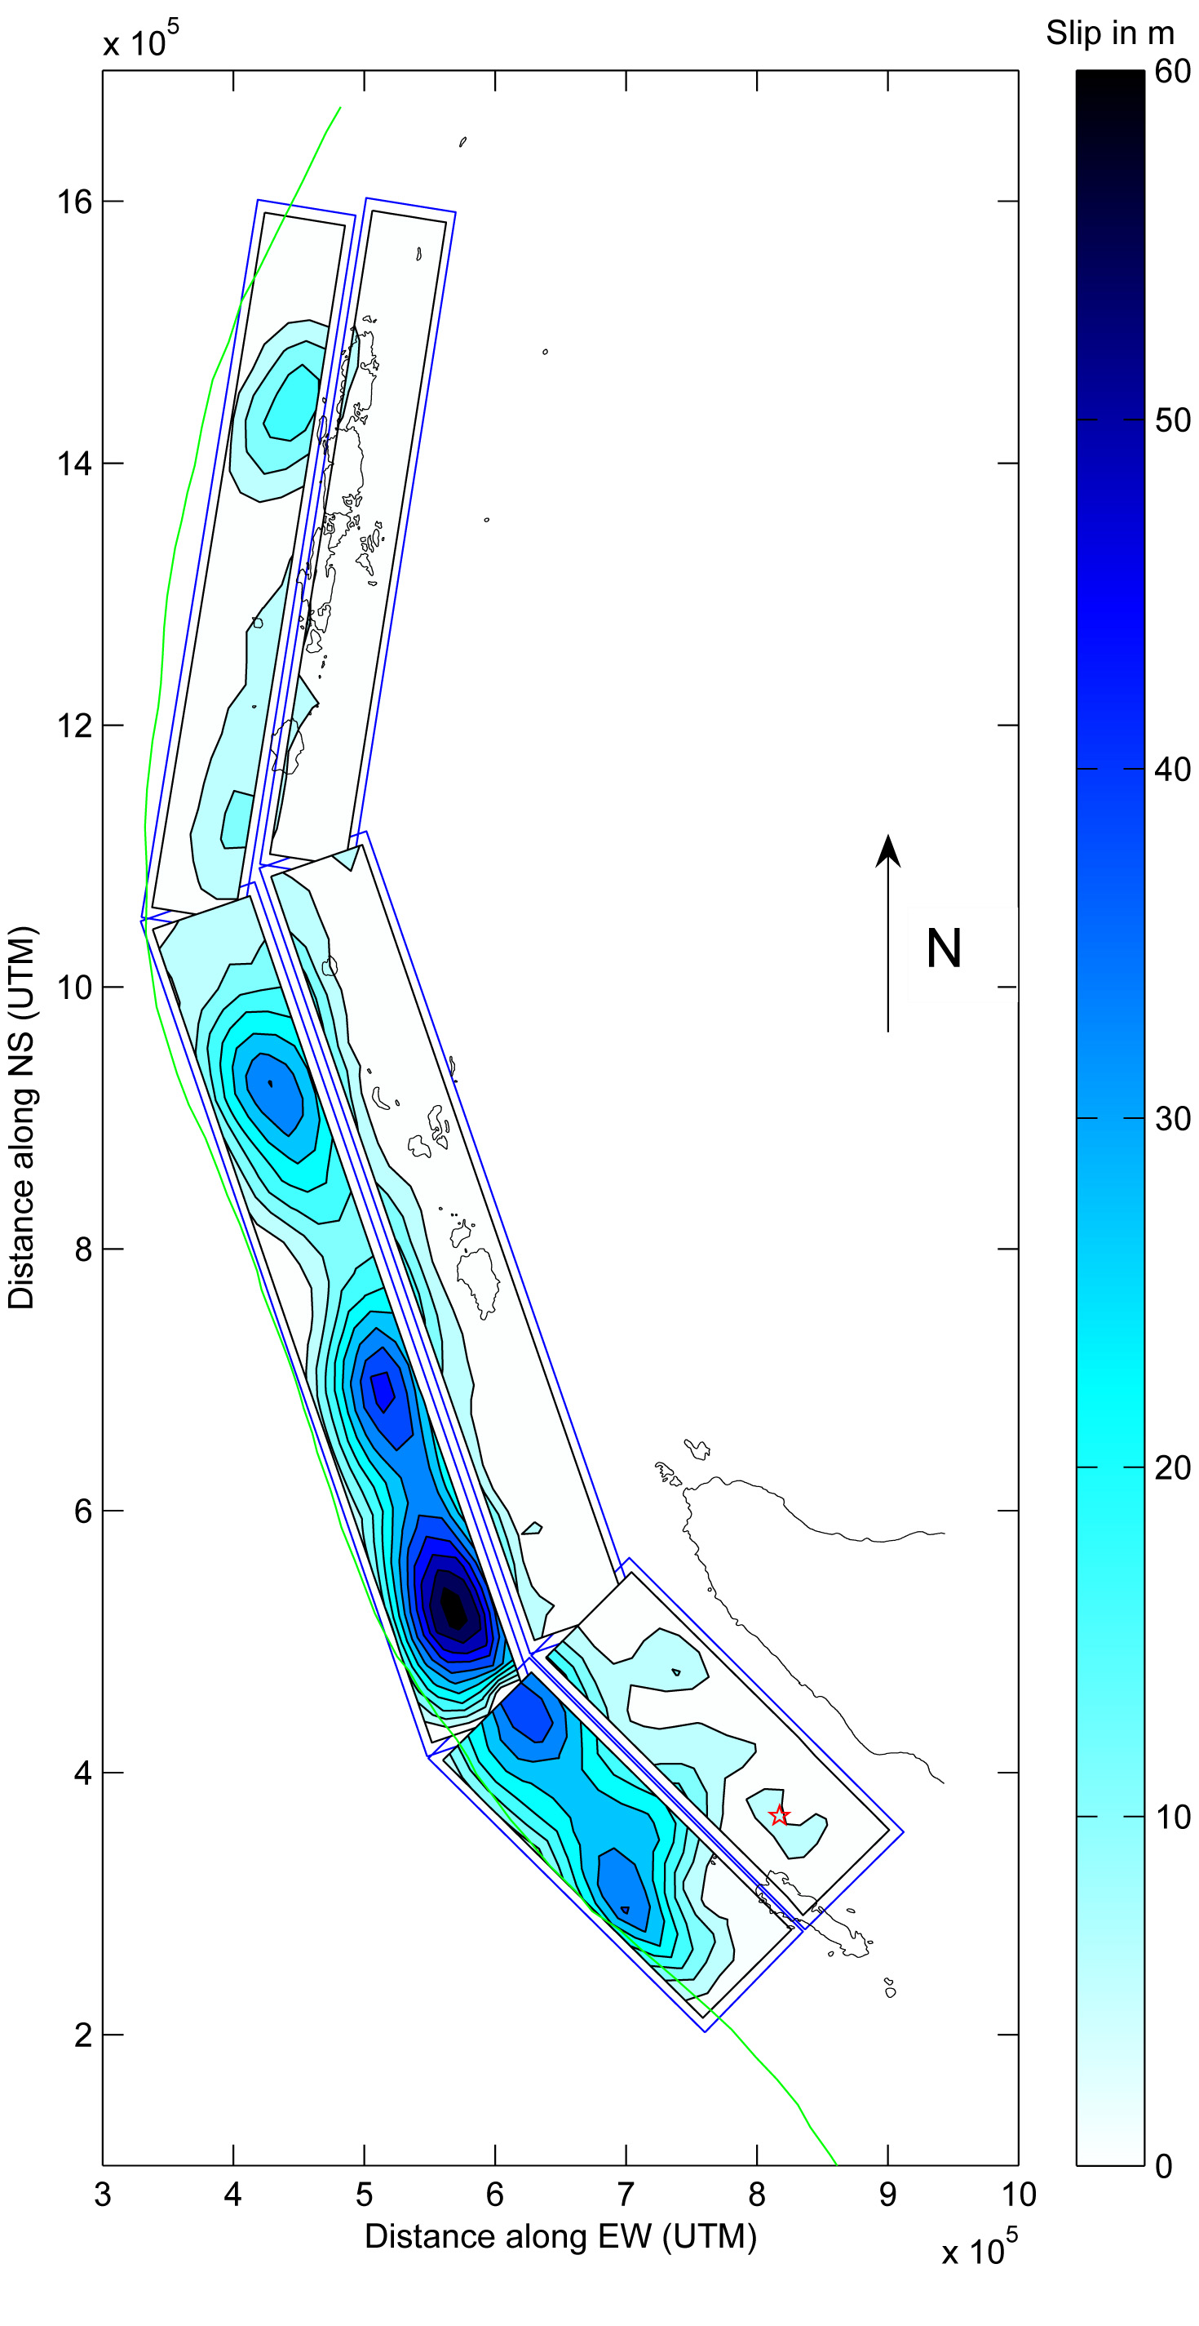
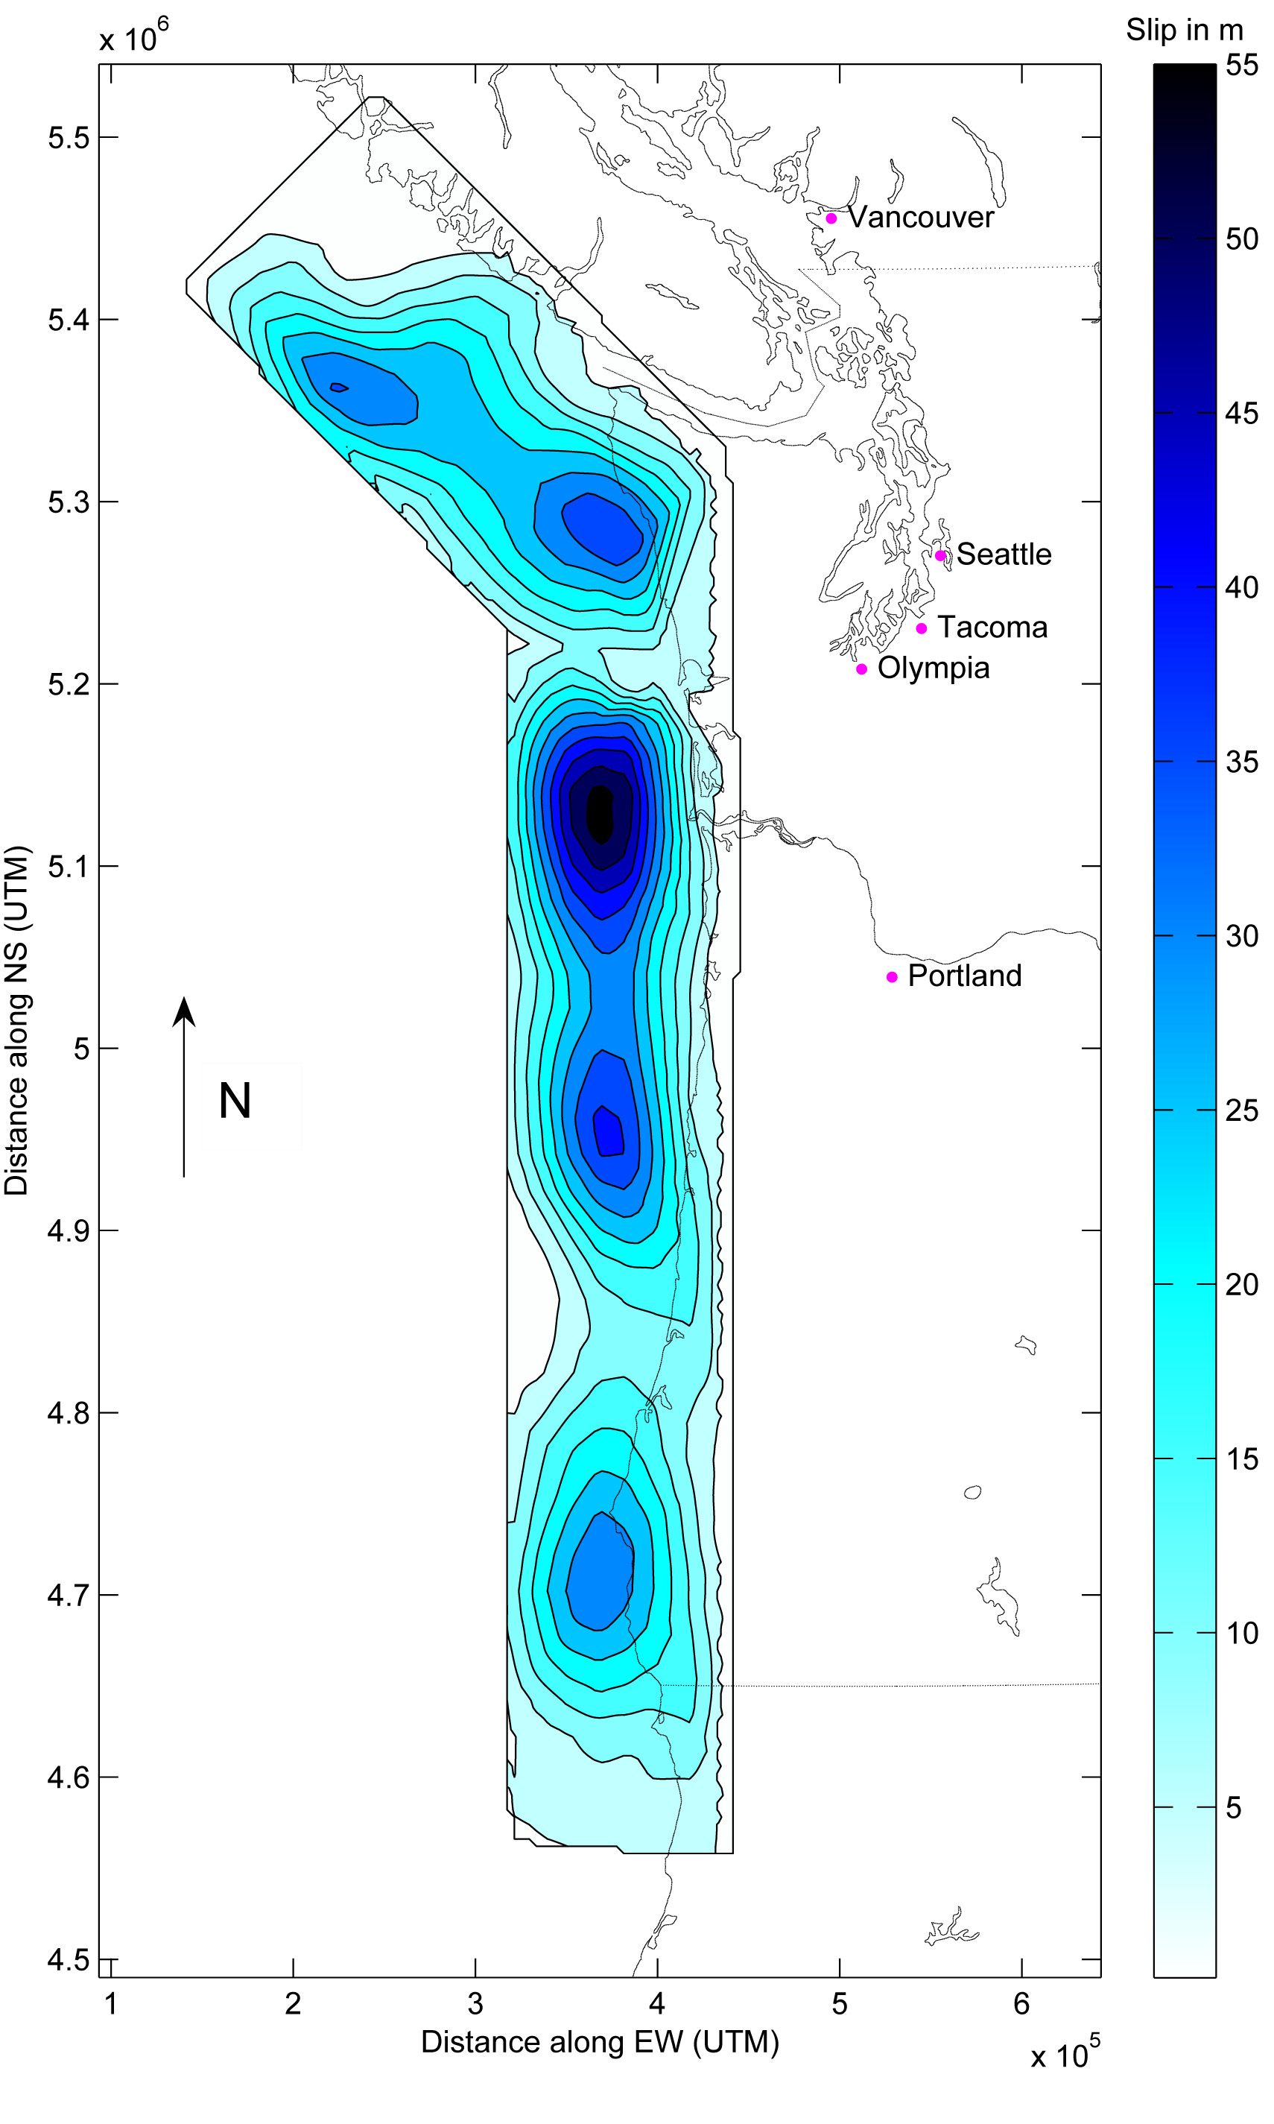
Sumatra-Andeman Pacific Northwest
Cascadia

Slide 15
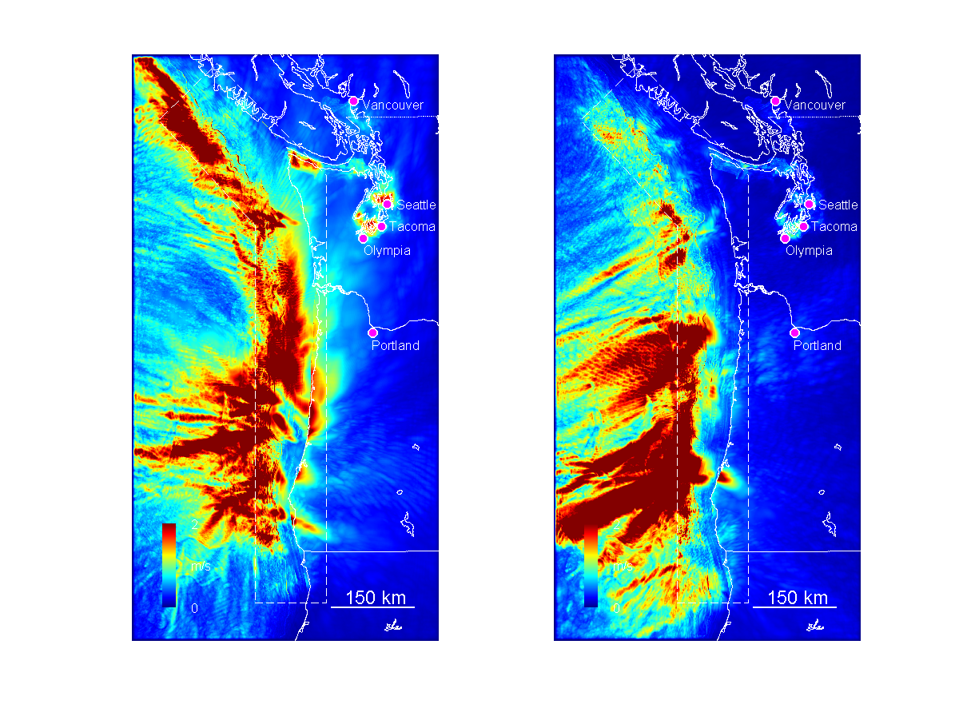
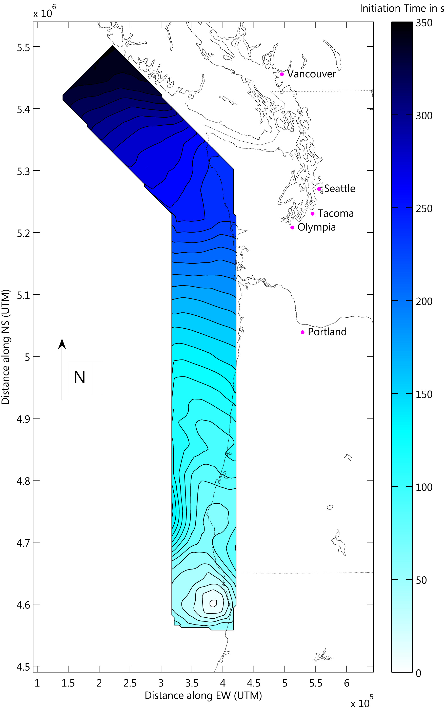
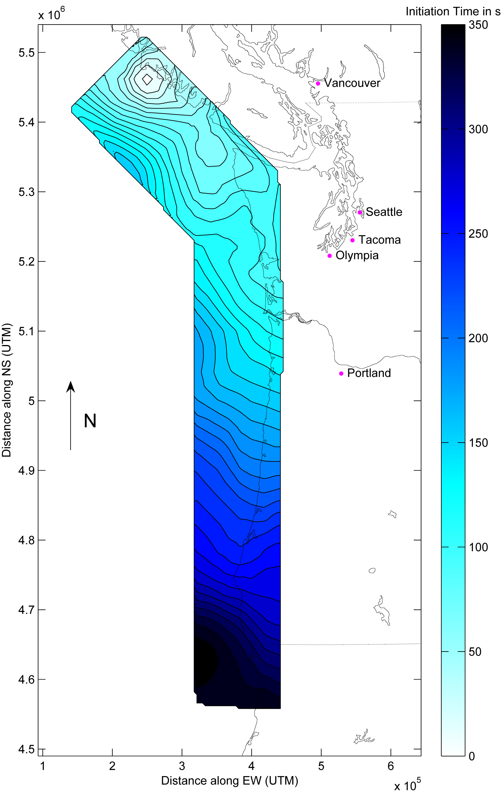
PGV S-N Rupture PGV N-S Rupture

Slide 16
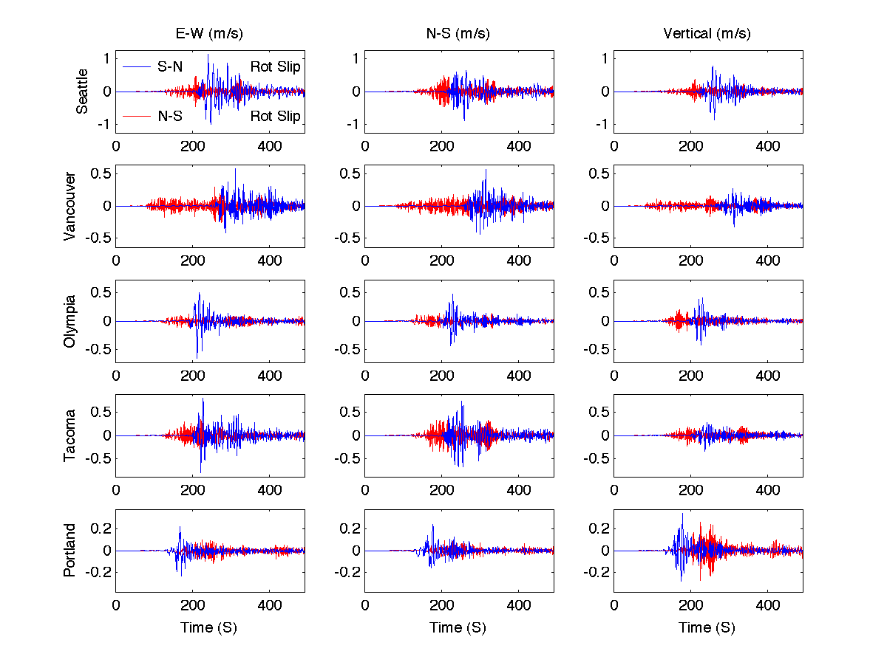
N-S Versus S-N Rupture

Slide 17
Central US
New Madrid Seismic Zone

Slide 20
PGVs for M7.6 Central Segment

